Slide 1

Single app for multiple solutions
Team member
Deep Shahane
Priya Raut
Pratik borhade
Prathamesh navale
Hrishikesh Kulkarni
Chaitanaya salunke

Slide 2



App is divided into 5 parts :
Advertisement
Lost and found
Event
Placement
Review

Slide 3
Things related to project
Advantages :
Smart product
Time saver
Convenient
Here you can submit review ,find lost item order food etc. by just a click of your hand.
Disavdantages :
You have to collect item physically from office.
Payment gateway is not integrated for food order process.
App is still in development stage.

Slide 4
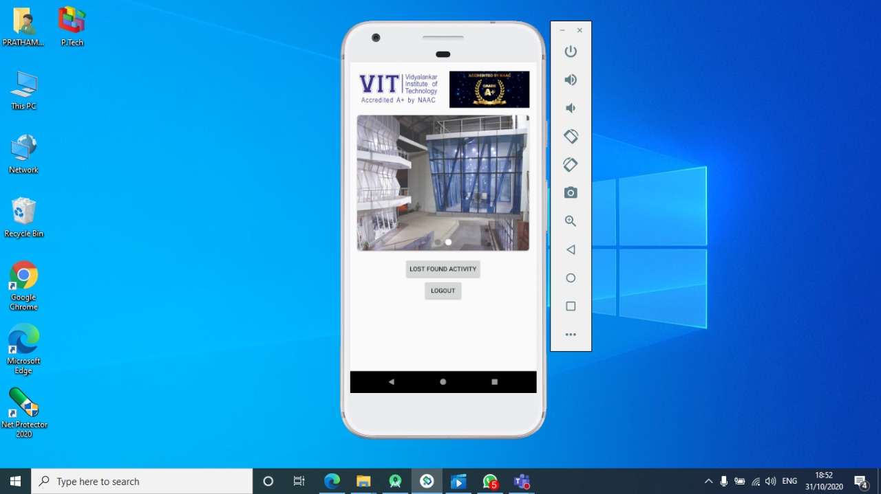
Demo App
Things We Can Improve
Add payment gateway
Add delivery option
Order cancelation

Slide 5

Thank You!
someone@example.com

